Slide 1


Art Heist
Demon Hacks 2020 Project
Aakash Jariwala, Ramiz Arif, Gideon Thomas, Sujal Timilsina

Slide 2

Our Mission
We wanted to create a platformer-style game while incorporating the hackathon theme of art
We decided to use python to code our game, utilizing the Pygame library to help us develop
We decided to draw everything in our game by hand on a tablet, except for the backgrounds of the levels, to emphasize art

Slide 3


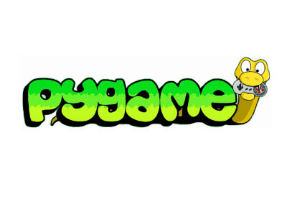

Resources Used
Visual Studio Code 2
Pygame Library
GitHub
Python

Slide 4

What Does Our Game Do?
The menu screen provides options to customize your character’s color, view the instructions, view the credits, and begin playing the game
The goal of our game is to reach the painting at the end of each level while avoiding the monitoring guards. Each time the painting is reached, the score increases and the level advances
If the character’s hitbox collides with the guard, the character dies and respawns at the beginning of the level

Slide 5

Stages
Planning Stage:
Discussed functions necessary to code
Broke the game into 4 phases that should merge together
Images/characters/background
Movement of characters
Creation of windows that lead to different screen
Interaction of Objects
Testing Phase
Break into roles
Each person took up on a role and began coding

Slide 6

Stages
Debugging Stage
Anytime a problem seemed to hinder progress, we called a “council” meeting
Here we displayed the code on a main screen and walked through it as a group
Once something was resolved, we pushed the code on GitHub so that the code could be distributed
Concluding Stages
Once the level and entities, objects and interactions within the levels were finished the code was merged
A test subject was asked to come in and play the level as he would and any little bugs were fixed through the test, leading to cleaner version of the level

Slide 7

Future of Our Game
Adding more levels to the game: This will be much easier to do now that we have classes for each part of the level that can easily be created for each new level
Improve gravity physics to prevent character from fluttering
Score at the end of the game that combines number of attempts and the time taken to complete the game in order to provide a star rating
Adding more character skins
Adding weapons for the player and the enemies to allow for combat within the levels
2 player functionality: one player controls with arrow keys and another with wasd
Change sprites for characters while the character is moving

Slide 8

Thanks for viewing our slide show and we hope everyone can reach this screen as they play our game!
- Ramiz, Gideon, Suj, and Aakash

